Slide 1

Tsinghua High School
Evaluation and Prediction of Cell Phone Sales Based on Various Techniques
Lingwei Cao, Cheng Qian, Zhaoyang Tian
Tsinghua High School
Advisor: Hao Wu, Dianjun Wang

Slide 2
Agenda
Research Background
Assumptions & Justifications
Data Extraction & Process
Modeling
Optimization
Application
Sensitivity Analysis
Conclusion

Slide 3
Tsinghua High School
01
Research Background
Research Purposes and General Process

Slide 4


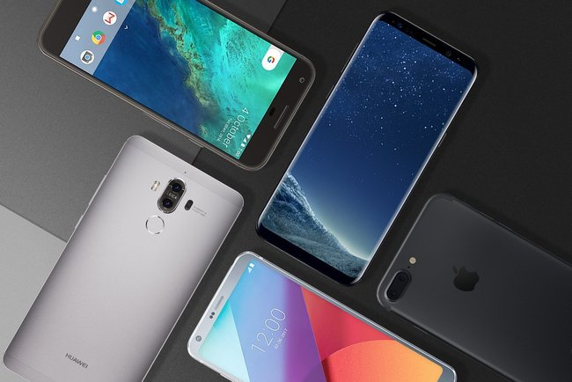

Problem definition
Technology advancement
Online shopping
Fast-pace life
Manufacturers and sellers
Target： Cellphones
Key factor
Sales promotion

Slide 5
Research Background
Previous Research
Grey Relational Analysis——Fatao Wang 2013
C2C Model——Youzhi Xue 2012
BP Neural Network Fitting——Yanli Ma 2014
Weakness
Fail to analyze influential factors in a systematic and comprehensive way
Fail to reveal specific traits that contribute to higher sales volume
Purpose
Rank influential factors
Determine specific traits
Predict sales volume with given traits

Slide 6
Raw Data
Ali Express
Data Extraction
Extract relevant variables
Data Process
Modeling
qualitative conclusions
Reduce variables
General Research Process
Conclusion
Application
statistic results
strength and weakness
precision assessment
predict sales volume
quantitative conclusions
Sensitivity Analysis
Optimization

Slide 7
Tsinghua High School
02
Assumptions & Justifications
To simplify real-world imply cations without the loss of the core

Slide 8
Basic Assumptions
$$conversion rate=\frac{valuable clicks（users who buy）}{clicks（users who click）}$$
$$click rate=\frac{clicks（users who click）}{ views （users who browse）}$$
$$click rate×conversion rate=sales rate$$
Sales volume

Slide 9
Tsinghua High School
03
Data Extraction & Process
Find key independent variables

Slide 10

Information Entropy
What is Information Entropy
Why choose it
Sift out the most important independent variables
How to apply it to independent variables
Based on relationship with Category Conversion and Click Rate
ROM(GB) | Group number in Category Click Rate | 1 | 2 | 3 | 4 | 5 | Information entropy
 | 2 | 0 | 3 | 2 | 1 | 0 | 1.459148
 | 4 | 5 | 6 | 13 | 7 | 0 | 1.89366
 | 8 | 64 | 38 | 63 | 54 | 8 | 2.122787
 | 16 | 110 | 89 | 132 | 143 | 36 | 2.205866
 | 32 | 64 | 44 | 82 | 63 | 29 | 2.242444
 | 64 | 83 | 38 | 62 | 49 | 16 | 2.160525
 | 128 | 3 | 4 | 5 | 7 | 0 | 1.931295
 | 256 | 0 | 0 | 1 | 0 | 0 | 0

Slide 11

Information Entropy
How to apply it to independent variables
Apply the result to find information gain
$$IGain\left(Category Click Rate, Rom\right)=E\left(global\right)−\sum{Information Entropy×Probability}$$
 | Category Click Rate | Category Conversion Rate
Global information entropy | 2.200779 | 2.081891
 | Sum of the products | Information Gain
ROM | 2.174619842 | 0.026159369
Ranking of variables depends on Category Click Rate | Information Gain
Comment Count | 0.732792417
Good Comment Count | 0.680453664
Search Count | 0.392386753
Score | 0.173242295
Brand | 0.124112475
Is Gallery Featured | 0.060358001
Battery Capacity(mAh) | 0.050232189
RAM(G) | 0.031072544
Ranking of variables depends on Category Conversion Rate | Information Gain
Comment Count | 0.950131659
Good Comment Count | 0.910616696
Search Count | 0.631528548
Score | 0.288394004
Brand | 0.261397755
Is Gallery Featured | 0.220147548
Battery Capacity(mAh) | 0.102065066
Highest camera resolution | 0.067310002

Slide 12
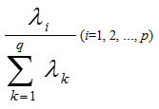
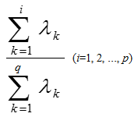




Principal Component Analysis
Purpose:
Reduce parameters
Retain the original data information as much as possible.
Methods:
Use formulas above to standardize data
Calculate eigenvectors and total contribution rates of PCA.
The first 14 principal components (contribution rate over 80%) are selected.
$$z_{1}=a_{11}x_{1}+a_{21}x_{2}+a_{31}x_{3}+a_{41}x_{4}+a_{51}x_{5}+…+a_{26 1}x_{26}$$
$$z_{2}=a_{12}x_{1}+a_{22}x_{2}+a_{32}x_{3}+a_{42}x_{4}+a_{52}x_{5}+…+a_{26 2}x_{26}$$
$$…$$
$$z_{14}=a_{1 14}x_{1}+a_{2 14}x_{2}+a_{3 14}x_{3}+a_{4 14}x_{4}+a_{5 14}x_{5}+…+a_{26 14}x_{26}$$

Slide 13
Tsinghua High School
04
Modeling
Qualitative conclusion and in-depth analysis

Slide 14

Modeling
Weight Determination Technique
Target Layer (RAM)
P₁
P₂
P₃
Scheme Layer(Click Rate)
C₁
C₂
C₃
C₄
C₅
$$Aw=λw$$
Among phones with middle display resolution, both phones with higher click rate and lower click rate takes a large proportion.
Logistic Regression
Click Rate | Conversion Rate
0.115124 | 0.162528
KNN Algorithm

Slide 15
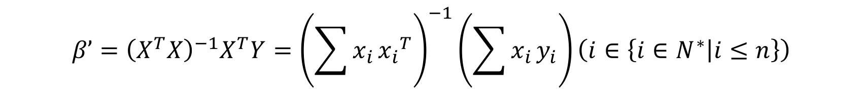
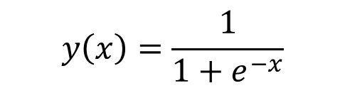

Logistic Regression
$$y_{n}=β_{0}+β_{1}x_{1}+β_{2}x_{2}+β_{3}x_{3}+β_{4}x_{4}+β_{5}x_{5}+β_{6}x_{6}\left(n∈\left\{1,2\right\}\right)$$
$$β’={\left(X^{T}X\right)}^{−1}X^{T}Y={\left(\sum{x_{i}}{x_{i}}^{T}\right)}^{−1}\left(\sum{x_{i}}y_{i}\right)\left(i∈\left\{i∈N^{∗} | i≤n\right\}\right)$$
$$P\left\{{\hat{θ}}_{1}<θ<{\hat{θ}}_{2}\right\}=1−α$$
$$P\left\{{\hat{β}}_{n 1}<β<{\hat{β}}_{n 2}\right\}=1−α \left(n∈\left\{n∈N^{∗} | n≤2\right\}\right)$$
$$y\left(x\right)=\frac{1}{1+e^{−x}}$$

Slide 16
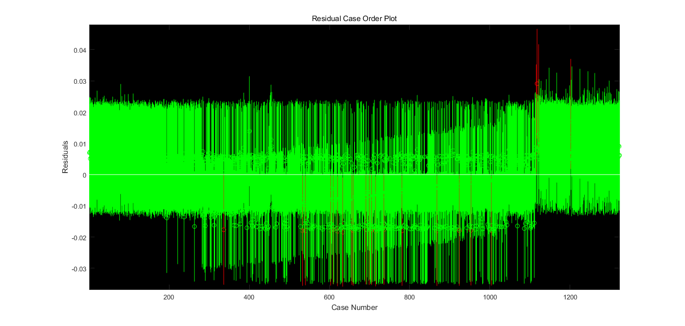
Logistic Regression
Not much Outliers.

Slide 17
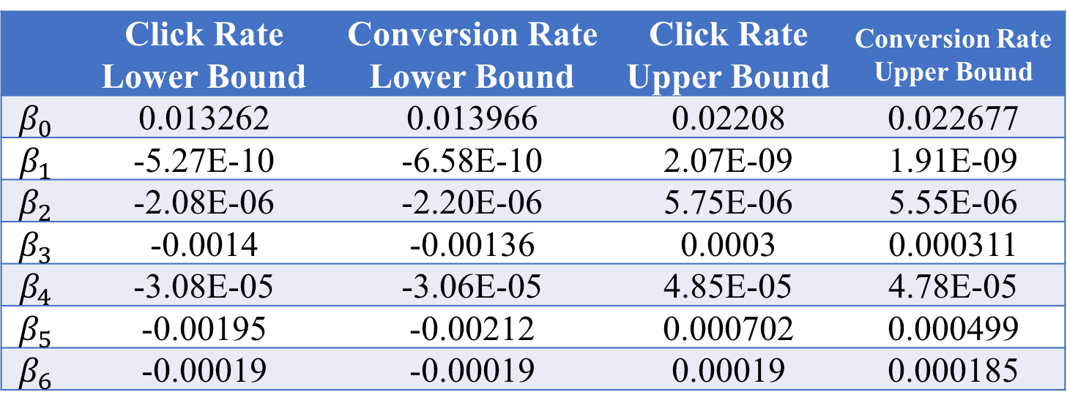
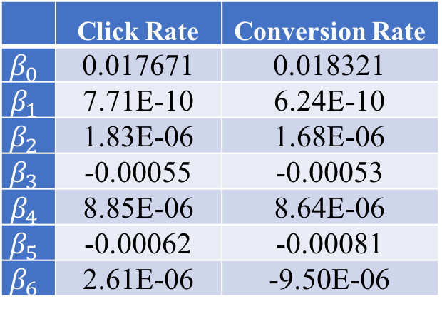
Logistic Regression
The low correlation coefficients in Logistic Regression is insufficient to reveal the features of each variable precisely.
 | Click Rate | Conversion Rate
$$β_{0}$$ | 0.017671 | 0.018321
$$β_{1}$$ | 7.71E-10 | 6.24E-10
$$β_{2}$$ | 1.83E-06 | 1.68E-06
$$β_{3}$$ | -0.00055 | -0.00053
$$β_{4}$$ | 8.85E-06 | 8.64E-06
$$β_{5}$$ | -0.00062 | -0.00081
$$β_{6}$$ | 2.61E-06 | -9.50E-06
Click Rate | Conversion Rate
0.115124 | 0.162528
 | Click Rate Lower Bound | Conversion Rate Lower Bound | Click Rate Upper Bound | Conversion Rate Upper Bound
$$β_{0}$$ | 0.013262 | 0.013966 | 0.02208 | 0.022677
$$β_{1}$$ | -5.27E-10 | -6.58E-10 | 2.07E-09 | 1.91E-09
$$β_{2}$$ | -2.08E-06 | -2.20E-06 | 5.75E-06 | 5.55E-06
$$β_{3}$$ | -0.0014 | -0.00136 | 0.0003 | 0.000311
$$β_{4}$$ | -3.08E-05 | -3.06E-05 | 4.85E-05 | 4.78E-05
$$β_{5}$$ | -0.00195 | -0.00212 | 0.000702 | 0.000499
$$β_{6}$$ | -0.00019 | -0.00019 | 0.00019 | 0.000185

Slide 18
Tsinghua High School
05
Optimization
Algorithms for optimization
and quantitative conclusions

Slide 19
Principal Component Regression
$${y_{n}}^{∗}=β_{1}′z_{1}+β_{2}′z_{2}+β_{3}′z_{3}+…+β_{14}′z_{14}\left(n∈\left\{n∈N^{∗} | n≤2\right\}\right)$$
$$y_{n}=β_{0}+β_{1}x_{1}+β_{2}x_{2}+β_{3}x_{3}+…+β_{26}x_{26}\left(n∈\left\{1,2\right\}\right)$$
Click Rate | Conversion Rate
0.805032 | 0.826614

Slide 20
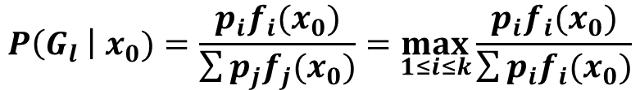
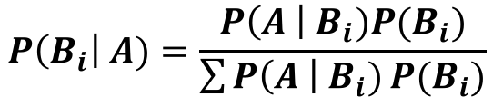
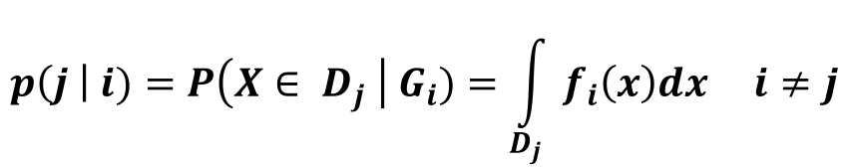
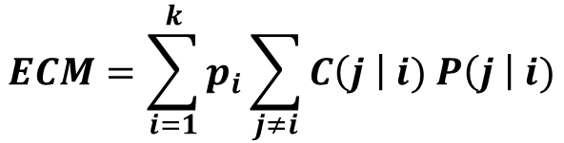
Bayes Distinction
 | High sales | Low sales
High display resolution | 7 | 1
Low display resolution | 3 | 9
$$P\left(B_{i}\right| A)=\frac{P\left(A \right|{ B}_{i})P(B_{i})}{\sum{P\left(A \right| B_{i})}P(B_{i})}$$
$$P\left(G_{l} \right| x_{0})=\frac{p_{i}f_{i}(x_{0})}{\sum{p_{j}f_{j}(x_{0})}}=\max_{1≤i≤k}{\frac{p_{i}f_{i}(x_{0})}{\sum{p_{i}f_{i}(x_{0})}}}$$
$$ECM=\sum_{i=1}^{k}{p_{i}\sum_{j≠i}{C\left(j \right| i) P\left(j \right| i)}}$$
$$p\left(j \right| i)=P\left(X∈ D_{j} \right| G_{i})=\int_{D_{j}}{f_{i}\left(x\right)dx i≠j}$$

Slide 21
Bayes Distinction
RAM to Click rate (the smaller the category is, the lower the click rate is)
 | Category 1 | Category 2 | Category 3 | Category 4
0.125 | 2 | 0 | 0 | 0
0.5 | 7 | 0 | 0 | 1
1 | 49 | 0 | 1 | 7
1.5 | 1 | 0 | 0 | 0
2 | 91 | 0 | 15 | 25
3 | 41 | 1 | 64 | 19
4 | 1 | 13 | 68 | 2
6 | 0 | 11 | 22 | 0
8 | 0 | 0 | 1 | 0
Phones with higher display resolution are apt to reveal more satisfactory sales volume.
Phones with medium RAM may experience low sales or high sales.

Slide 22
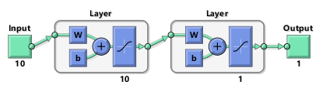
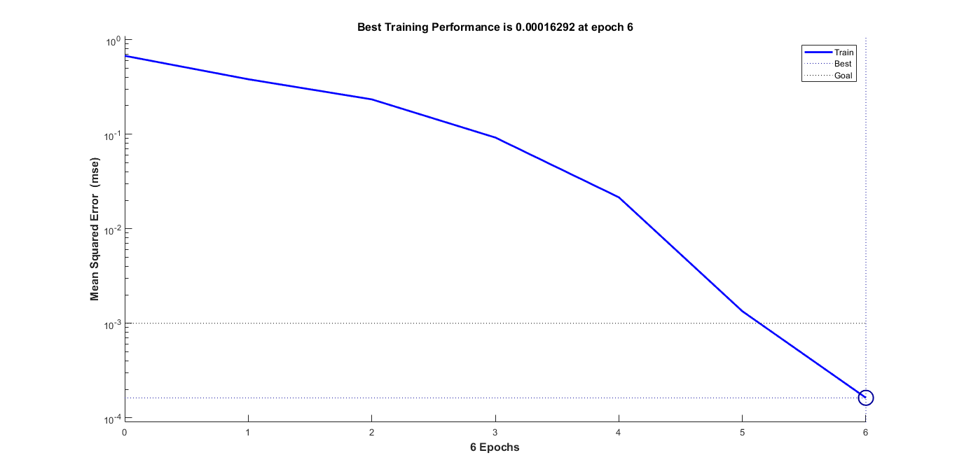
BP Neural Network
Model with 10 layers do not consume too much time, while it has a better performance.
The error is decreasing rapidly.
The error of some data is lower than 1%.

Slide 23
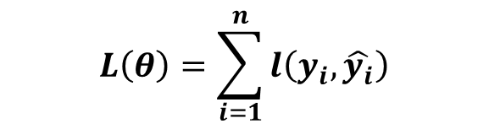
XGBoosting Algorithm
$$L\left(θ\right)=\sum_{i=1}^{n}{l\left(y_{i},\hat{y_{i}}\right)}$$
Age | Monthly shopping Amount | Usually asking or answering on Quora
14 | Less than 1000 yuan | Asking
16 | Less than 1000 yuan | Answering
24 | More than 1000 yuan | Asking
26 | More than 1000 yuan | Answering
Combining several weak classifiers into a strong classifier to
further minimize loss function and error.

Slide 24
Tsinghua High School
06
Application
To predict sales volume with given traits

Slide 25

Application
Test Set
Model
XG Boosting
Predict Sales Volume
Score
$$S_{k}=max\left(0,10−10×\left|\frac{\log_{10}\left|\frac{x_{predict}}{x_{real}}\right|}{5}\right|\right)$$
Click rate：9.81
Conversion rate：9.74
Battery | RAM | CPU | Display | Price | CR/P | CVR/P | CR | CVR | CR/S | CVR/S
2800 | 1.0 | 2.0 | 5.0 | 49.49 | 0.0241 | 0.0223 | 0.0204 | 0.0224 | 9.855 | 9.996
3400 | 1.0 | 2.0 | 4.5 | 75.99 | 0.0198 | 0.0226 | 0.0243 | 0.0226 | 9.822 | 10
2500 | 1.0 | 2.0 | 5.5 | 49.99 | 0.0213 | 0.0226 | 0.0221 | 0.0225 | 9.968 | 9.996
1050 | 0.5 | 3.0 | 2.4 | 109.0 | 0.0241 | 0.0223 | 0.0242 | 0.0222 | 9.996 | 9.996

Slide 26
Tsinghua High School
07
Sensitivity Analysis
To assess the accuracy and stability of models

Slide 27
Sensitivity Analysis
detect the stability of our model, especially when the given data are inaccurate
Sensitivity analysis
continuous variables
1% increase or decrease
Principal Component Regression: 1%
discrete variables
change the value of one parameter to adjacent category each time
eg. 2G to 4G
Bayes Distinction: 0
BP neural network: 1%
The largest remains unchanged
The output changes 0.1%

Slide 28
Tsinghua High School
08
Conclusion
Strength and weakness

Slide 29
Ranking of independent variables
Conclusion from data extracting
Ranking of independent variables | Independent variables
1 | Comment count
2 | Good comment count
3 | Search count
4 | Score
5 | Brand
6 | Is Gallery Featured
7 | Battery Capacity
8 | Highest camera resolution

Slide 30
Conclusion of modeling and optimization
Most popular traits
medium display resolution
low or high recording resolution
high camera resolution
medium price
Traits of best model predicted
medium battery capacity
gold or white color
high camera resolution

Slide 31
Discovery in analysis
Priority
Insensitive variables
Top three priorities are RAM, ROM, CPU when improving phone’s quality
Changes in display resolution and camera resolution

Slide 32
Strength of our methods
Qualitative analysis
Display straightforward analysis towards important independent variables
Variables ranking
Provide quantitative methods for the analysis of independent variables and the ranking of most important ones
Quantitative optimization
Present quantitative analysis towards specific traits of cell phones to guide further optimization
Predict the sales volume of cell phones based on the training set
Application value

Slide 33
Tsinghua High School
Thank You
Lingwei Cao, Cheng Qian, Zhaoyang Tian
Tsinghua High School
Advisor: Hao Wu, Dianjun Wang

